Slide 1
All Souls’ Day
We Remember our Family and Friends
who have died

Slide 2
We take the time for a moment of silence and remembering.
As the music “Goodbye for Now” is played,
we write the name(s) of our Loved Ones who have died on the piece of paper and place it on the altar.
Notes:
Another suitable song could replace Goodbye for Now

Slide 3

With love, we remember them.

Slide 4

Reader:
In the rising of the sun and in its going down
All:
With love,
we remember them

Slide 5
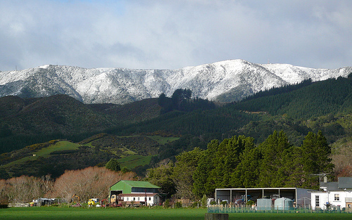
Reader:
In the blowing of the wind and in the chill of winter
All:
With love, we remember them

Slide 6

Reader:
In the opening of buds and in the rebirth of spring
All:
With love, we remember them

Slide 7
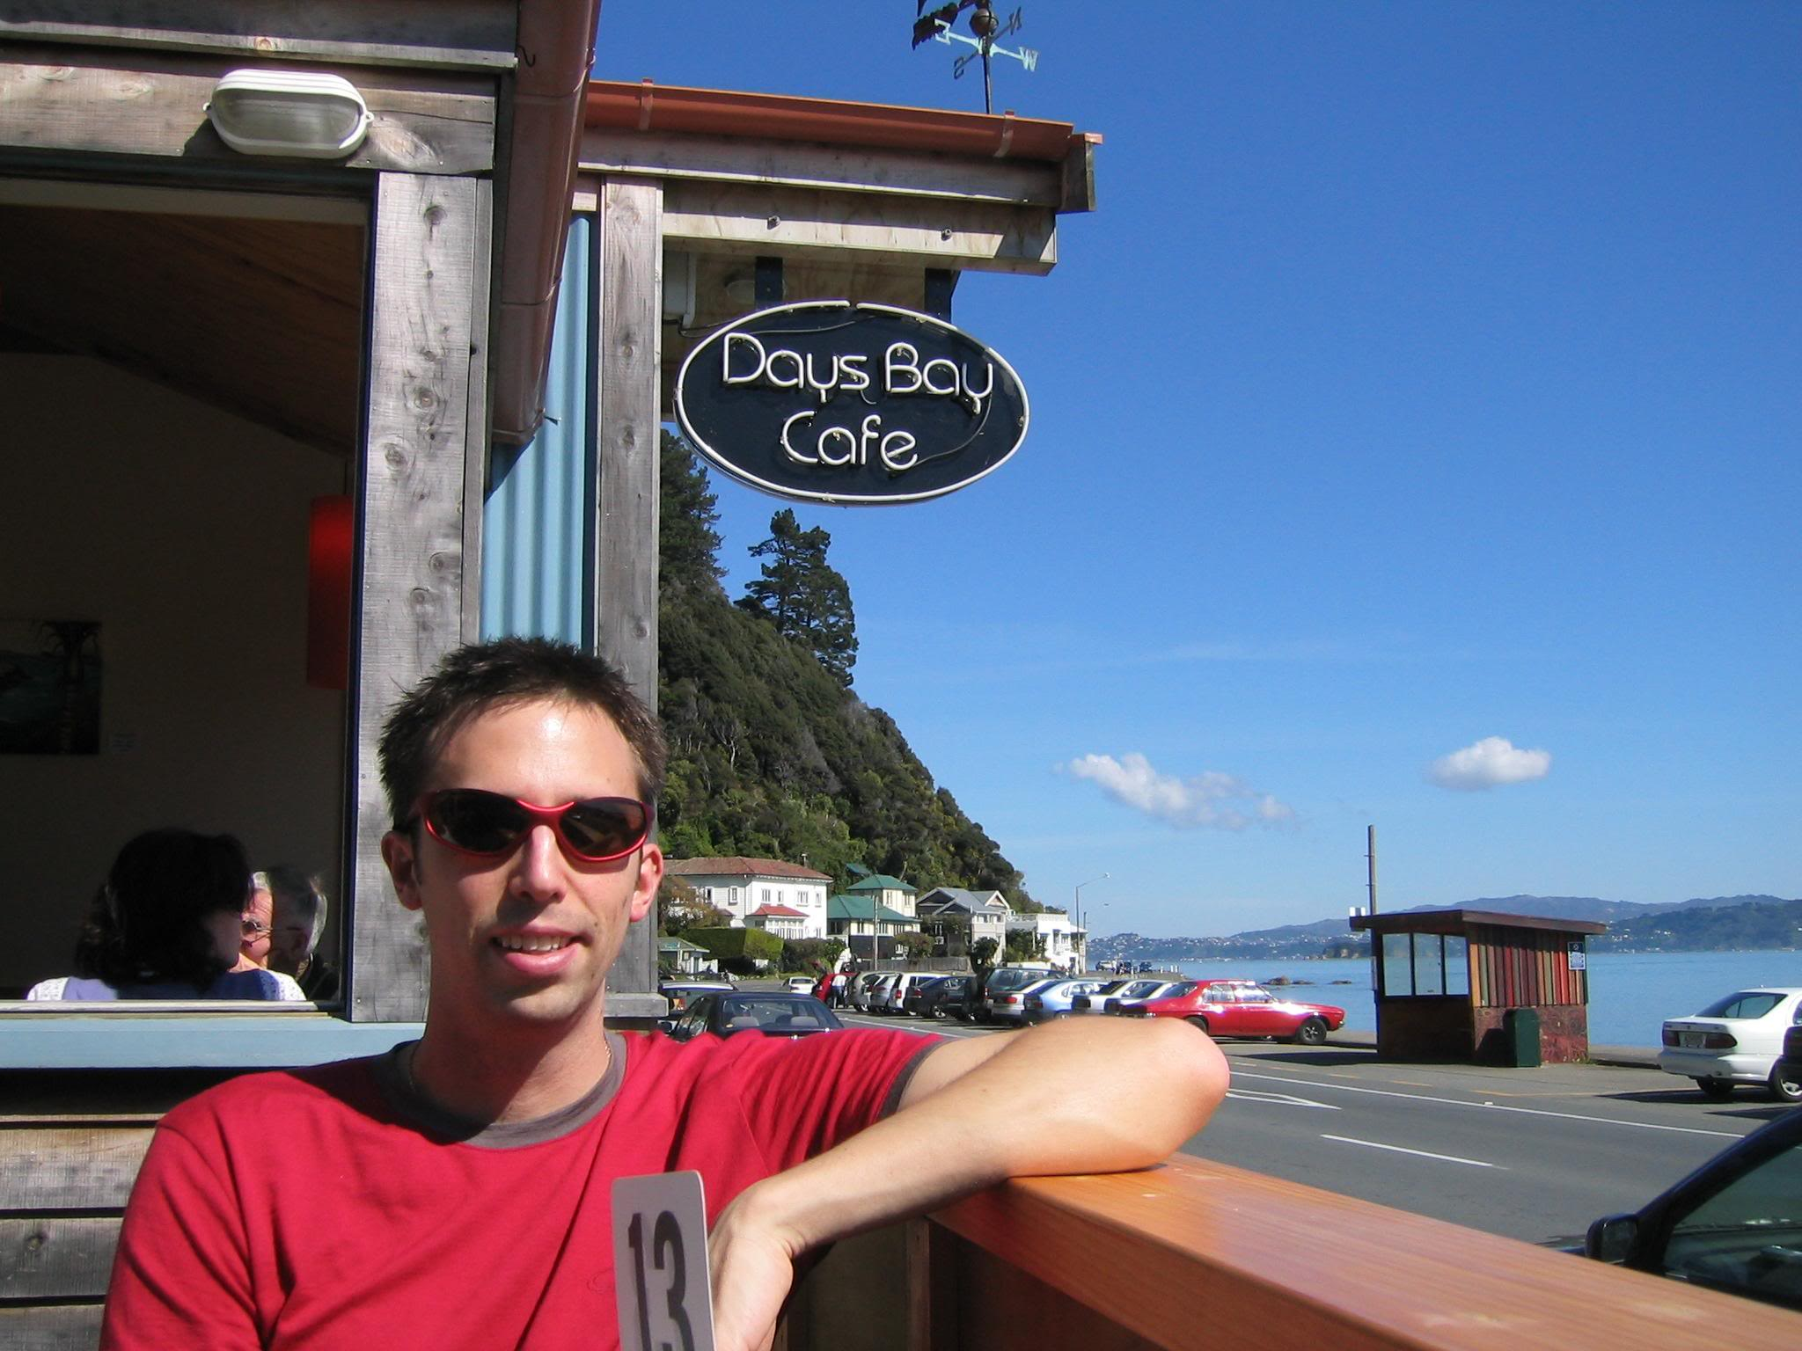
Reader:
In the blueness of the sky and in the warmth of summer
All:
With love, we remember them

Slide 8
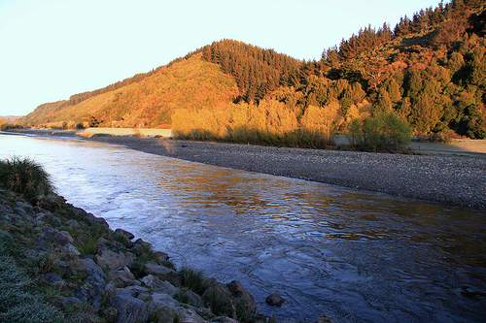
Reader:
In the rustling of the leaves and the beauty of autumn
All:
With love, we remember them

Slide 9

Reader::
In the beginning of the year and when it ends
All:
With love, we remember them

Slide 10

Reader:
When we are weary and in need of strength
All:
With love, we remember them

Slide 11
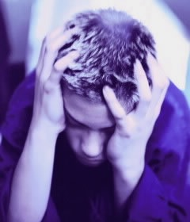
Reader:
When we are lost and sick at heart
All:
With love, we remember them

Slide 12

Reader:
When we have joys we yearn to share
All:
With love, we remember them

Slide 13

So long as we live, they too shall live, for they are now a part of us, as we remember them.
Though our departed are no longer with us, their memories are forever enshrined in our hearts.
Their influence lives with us, directing our thoughts and deeds toward the ideals they cherished and for which they strived.
With love, we will remember them.
Notes:
Animated by paragraph

Slide 14
A reading from Saint John’s Gospel
John 14
Jesus Is the Way to the Father
¹Jesus said to his disciples, "Don't be worried! Have faith in God and have faith in me. ²There are many rooms in my Father's house. I wouldn't tell you this, unless it was true. I am going there to prepare a place for each of you. ³After I have done this, I will come back and take you with me. Then we will be together. ⁴You know the way to where I am going." ⁵Thomas said, "Lord, we don't even know where you are going! How can we know the way?" ⁶"I am the way, the truth, and the life!" Jesus answered. "Without me, no one can go to the Father.

Slide 15
Before we go our separate ways, let us take leave of our brothers and sisters.
May our farewell express our affection for them; may it ease our sadness and strengthen our hope.
One day we shall joyfully greet them again when the love of Christ, which conquers all things, destroys even death itself.

Slide 16
Trusting in God, we have prayed together as a college community.
There is sadness in parting, but we take comfort in the hope that one day we shall see them again and enjoy their friendship. Although we do have sorrow, the love of God will gather us together again in the joy of his kingdom.
Therefore let us console one another in the faith of Jesus Christ.

Slide 17
Saints of God, come to their aid!
Hasten to meet them, angels of the Lord!
R: Receive their soul and present them to God the Most High.
May Christ, who called you, take you to himself; may angels lead you to Abraham’s side.
R: Receive their soul and present them to God the Most High.
Eternal rest grant unto them, O Lord,
and let perpetual light shine upon them.
R: Receive their soul and present them to God the Most High.

Slide 18
Eternal rest grant unto them, O Lord.
R: And let perpetual light shine upon them.
May they rest in peace.
R. Amen.
May their soul and the souls of all the faithful departed, through the mercy of God, rest in peace.
R. Amen.
May the love of God and the peace of the Lord Jesus Christ bless and console us
and gently wipe every tear from our eyes:
in the name of the Father, and of the Son, and of the Holy Spirit.
R. Amen.
The minister concludes: Go in the peace of Christ.
R. Thanks be to God.

Slide 19
STRONG AND CONSTANT
Text & Music: Frank Andersen msc.
© Chevalier Bookshop, Kensington, NSW
I WILL BE YAWEH WHO WALKS WITH YOU
YOU WILL BE ALWAYS WITHIN MY HAND
TAKE YOUR HEART AND GIVE IT ALL TO ME
STRONG AND CONSTANT IS MY LOVE
STRONG AND CONSTANT IS MY LOVE
Notes:
Another appropriate song could be substituted

Slide 20
SHOULD YOU WANDER FAR AWAY FROM ME
I WILL SEARCH FOR YOU IN EV’RY LAND
SHOULD YOU CALL THEN YOU WILL TRULY KNOW
STRONG AND CONSTANT IS MY LOVE
STRONG AND CONSTANT IS MY LOVE

Slide 21
WHEN YOU KNOW SORROW WITHIN YOUR LIFE
I WILL COME, I WILL EMBRACE YOUR HEART
THROUGH YOUR PAIN YOU WILL DISCOVER ME
STRONG AND CONSTANT IS MY LOVE
STRONG AND CONSTANT IS MY LOVE

